Slide 1
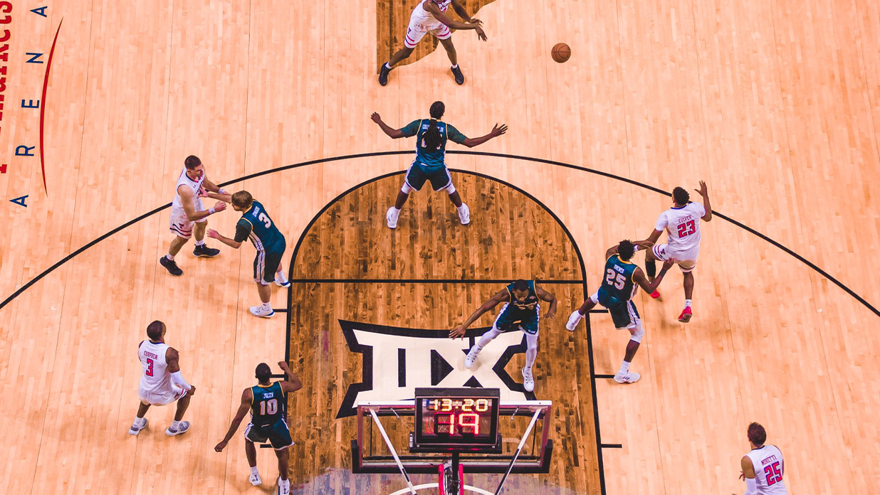
Modelling the NBA position(less)

Slide 2
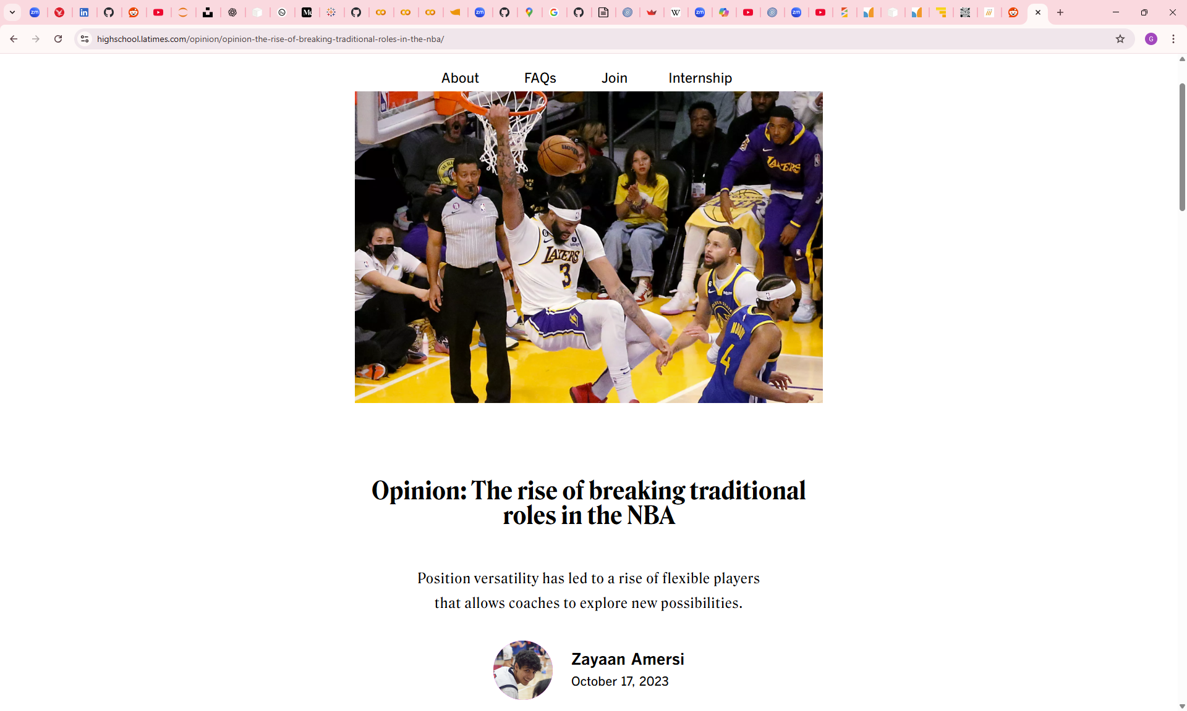
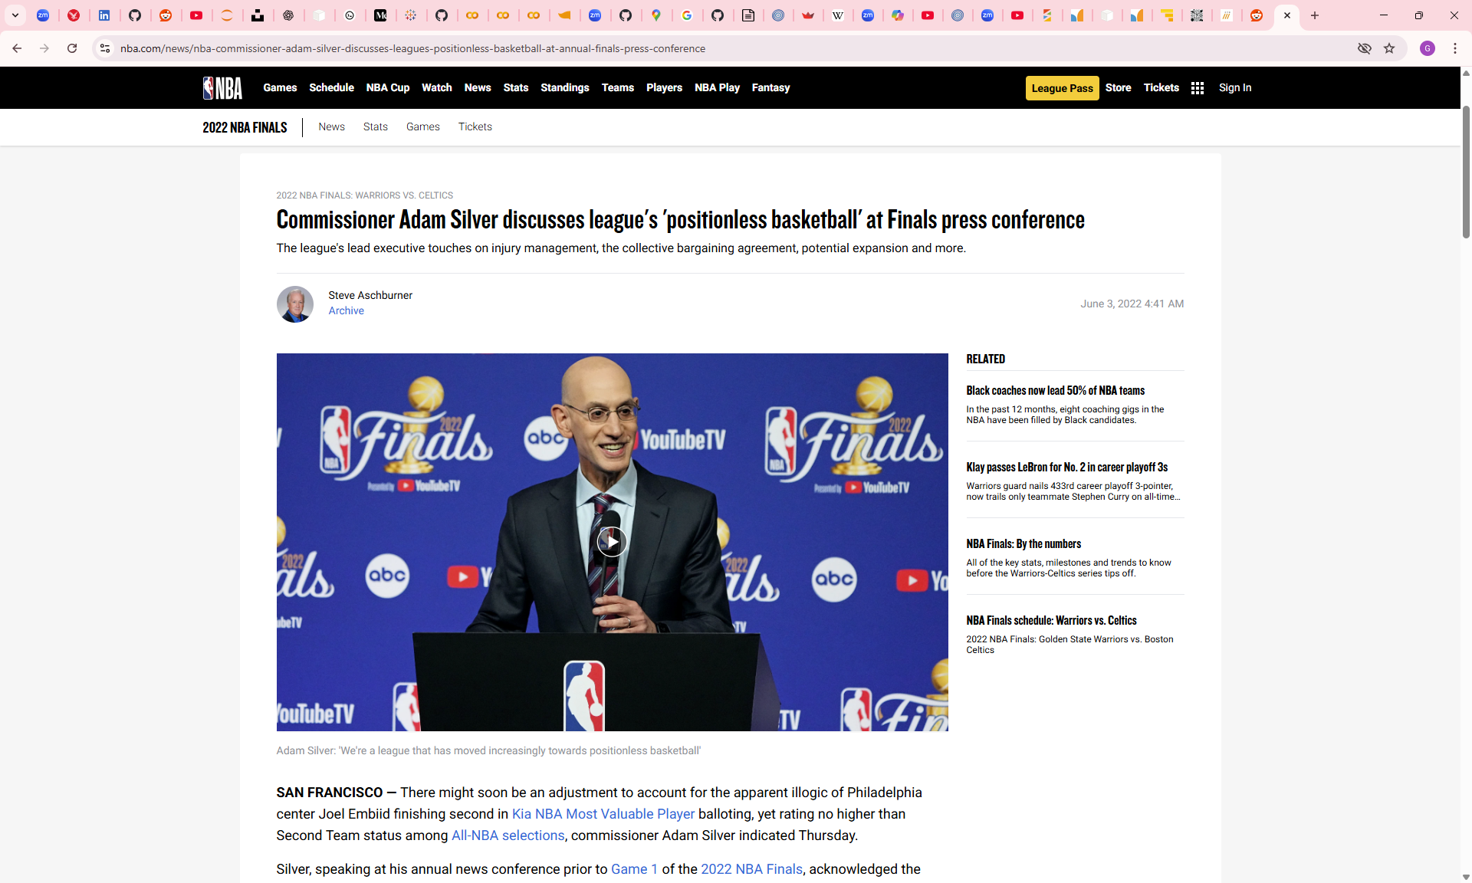
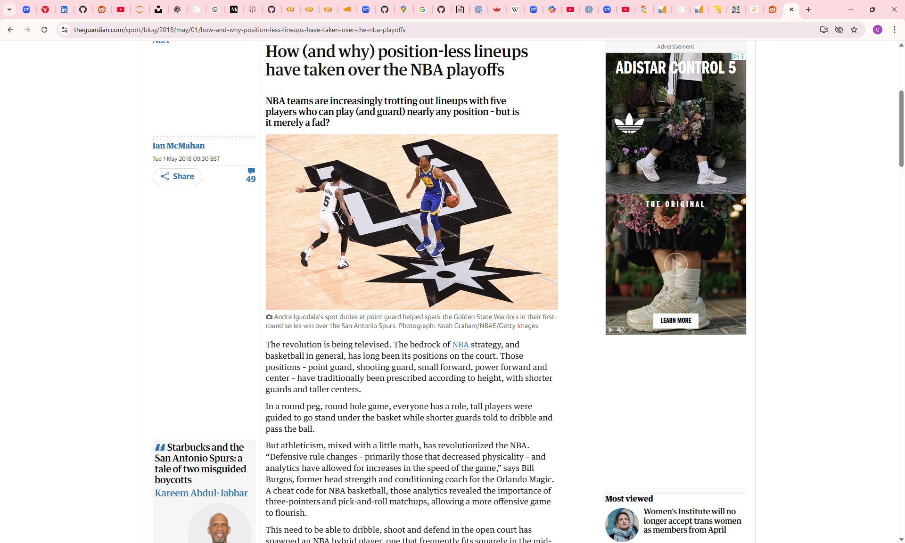
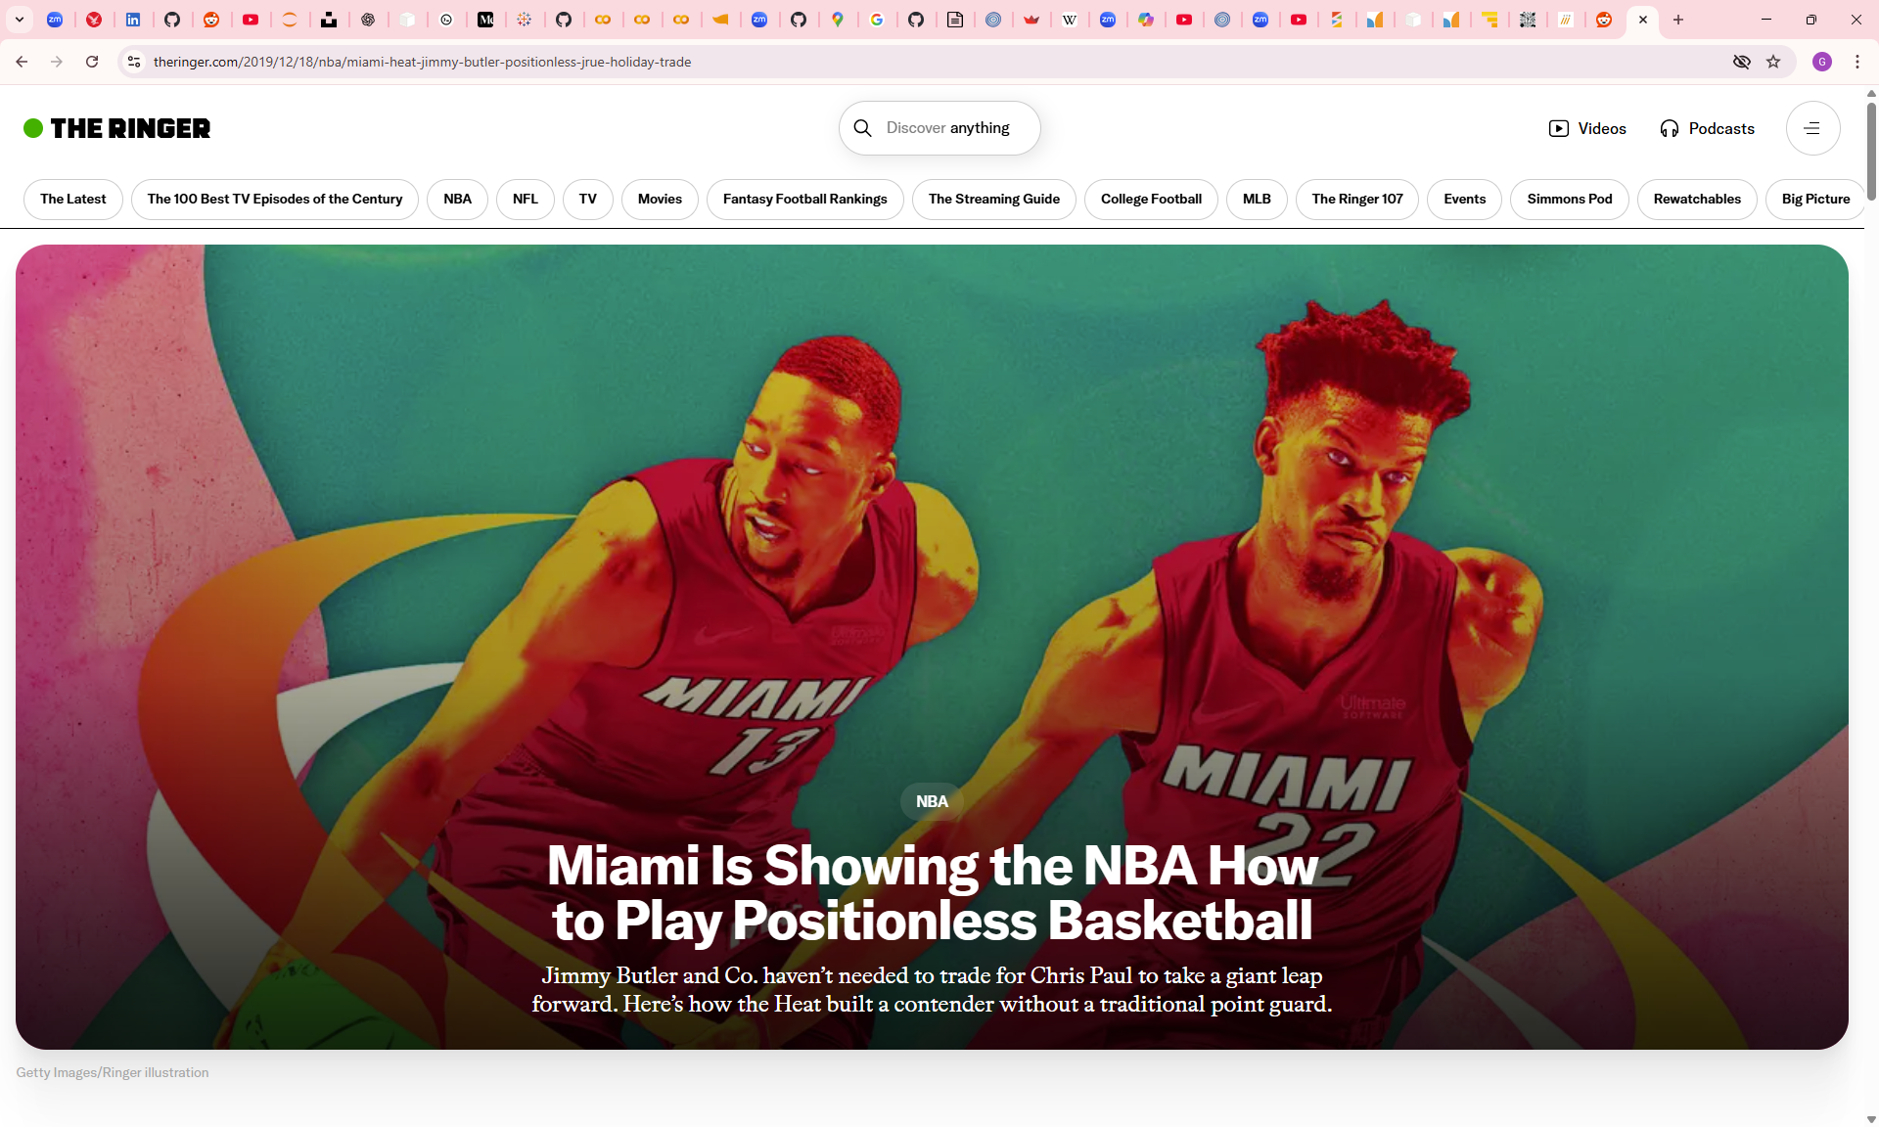
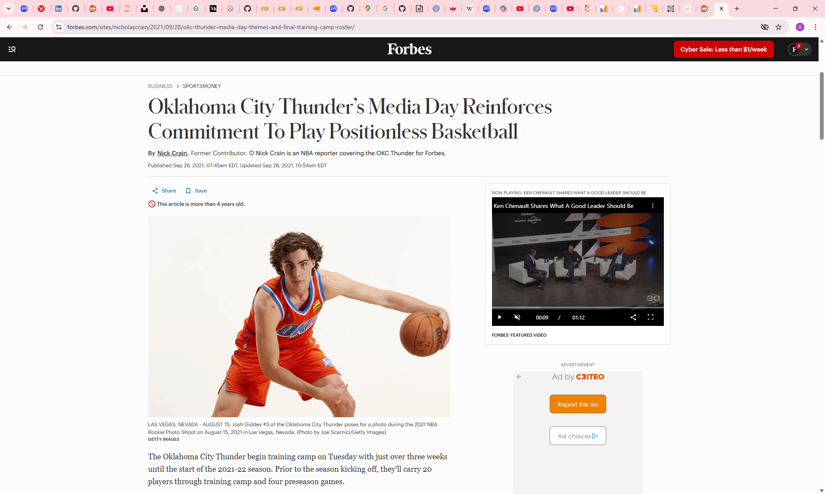
Positionless Basketball

Slide 3
Project goals
Data
Underlying NBA player statistics on scoring, defending, efficiency
Model
Make a model that accurately predicts a player positions
Output
Look to see if model uncertainty uncovers positionless players

Slide 4


Data Collection
Number of observations
3987
Number of variables
23
Years
2015-2025
Positions
3
Website scraped for player positions
Api used for underlying stats

Slide 5
Looking at the data
707
1713
1567

Slide 6
Modelling
LGBM
Logistic Regression
Meta Learner
SVM
Pros
Reduces model bias
Meta-learner can learn optimal blending
Flexible
Trained on data from 2015-2023
Predictions
Cons
Computationally expensive
Harder to interpret
Pipeline complexity
Tested on data from 2024-2025 season

Slide 7
Output
141
6
16
172
True Guard
Accuracy:
0.7888631
9
16
True Big
19
25
27
True Wing
Predicted Guard
Predicted Big
Predicted Wing

Slide 8

Positionless Players (2024-25)
 | Pred Pos | True Pos
Draymond Green | Wing | Big
Jaylon Tyson | Big | Guard
Jake LaRavia | Wing | Big
Harrison Barnes | Wing | Big
Jayson Tatum | Wing | Big
Wendell Moore Jr. | Wing | Guard
Jonathan Kuminga | Wing | Big
Max Strus | Guard | Wing
Kyle Anderson | Big | Wing
Ousmane Dieng | Wing | Big
Prob Guard | Prob Wing | Prob Big
0.32594 | 0.34024 | 0.33381
0.23639 | 0.32941 | 0.43420
0.24222 | 0.45872 | 0.29907
0.24645 | 0.46233 | 0.29123
0.21376 | 0.46253 | 0.32372
0.24672 | 0.48549 | 0.26779
0.24613 | 0.49957 | 0.25430
0.46386 | 0.35238 | 0.18377
0.19102 | 0.33058 | 0.47841
0.28555 | 0.51737 | 0.19708
5 out of 10 (50%)
NBA Champions
(~12% of NBA players are champions)

Slide 9
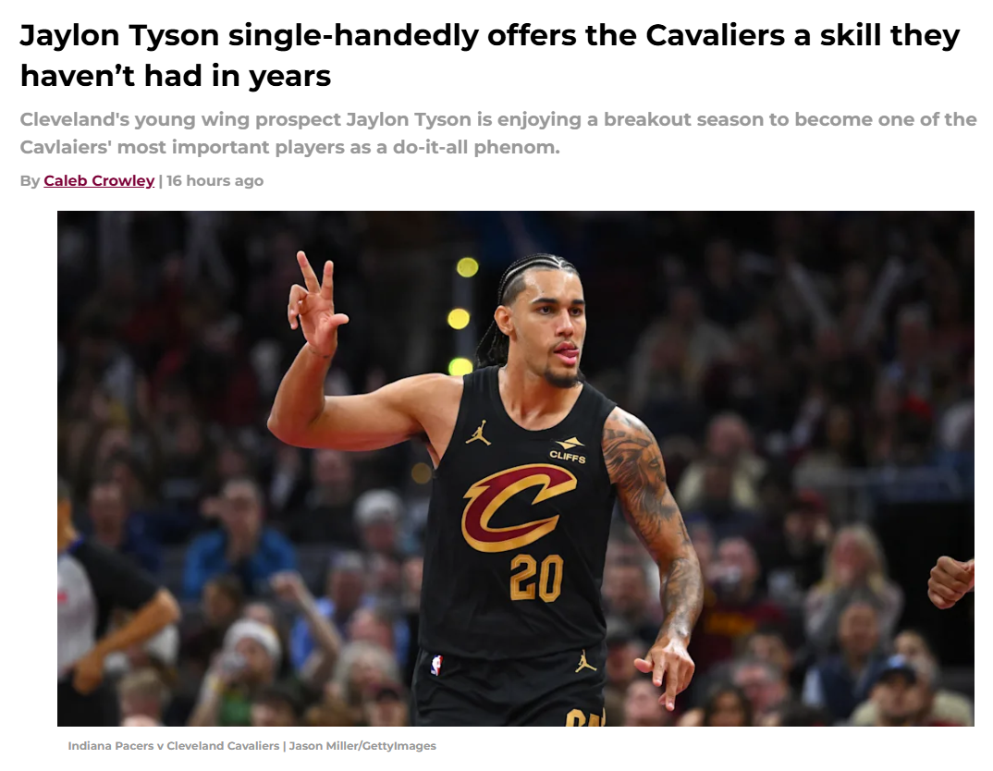
Jaylon Tyson
2024-25 Averages
Rebounds | Assists | Points
2.0 | 0.9 | 3.6
Current Contract | League Average
$3,492,480 | $11,910,649
2025-26 Averages
Rebounds | Assists | Points
5.0 | 1.8 | 12.5
3P FG% | Offensive rating
47.6% (5th) | 131.4 (13th)

Slide 10
Wrap up
Modelled player position at 80%
Model able to identify positionless players
Further able to identify unknown positionless players
Great information for: Scouts, negotiations, fantasy basketball, sports betting

Slide 11
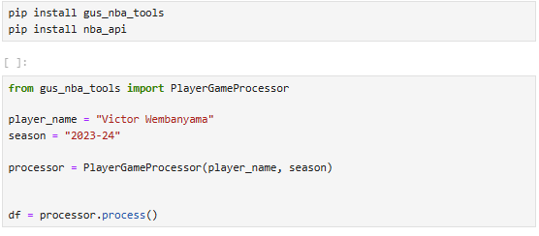
Victory is built on the shoulders of defeat

